Slide 1
UNHCR
Can we produce a practical
measure that can limit discriminatory
hiring practices? #WithRefugees
Notes:
3 questions:
Wouldn’t it be nice if every applicant to a job would be chosen because of their skills?
Wouldn’t it be nice if you wouldn’t have to individually apply to a hundred different jobs?
Wouldn’t it be nice if your boss was atleast aware that he was biased when he was recruiting?

Slide 2

#WITHREFUGEES ?
Despite rapid growth in the ICT sector, creating some 120,000 new jobs a year – and despite high unemployment, especially among the young – Europe could face a shortage of more than 800,000 skilled ICT workers by 2020. - Andrus Ansip European Commission, 2015
Citizenship | 2014 | 2015 | 2016 | Sum | Part of total
Syria | 30583 | 51338 | 5459 | 117369 | 17%
Iraq | 2666 | 20858 | 2758 | 90217 | 13%
Afghanistan | 3104 | 41564 | 2969 | 69242 | 10%
Somalia | 4831 | 5465 | 1646 | 50959 | 7%
[1]
Every third Syrian refugee has a >2 years post gymnasial education, or research experience [2]
Notes:
https://www.migrationsverket.se/download/18.585fa5be158ee6bf362fd2/1485556063045/Asyls%C3%B6kande+till+Sverige+2000-2016.pdf
https://www.svt.se/nyheter/inrikes/var-tredje-syrisk-flykting-hogutbildad.

Slide 3
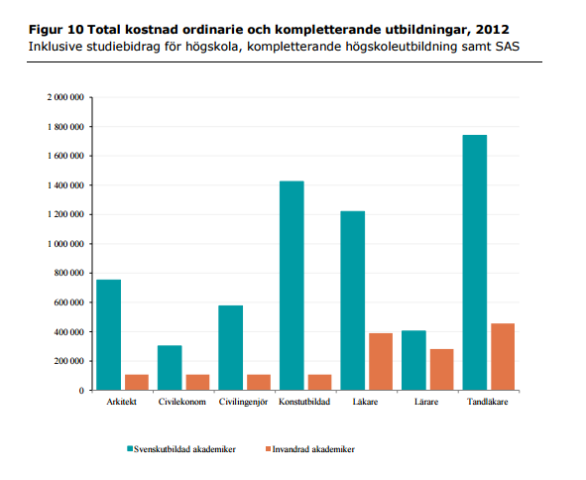
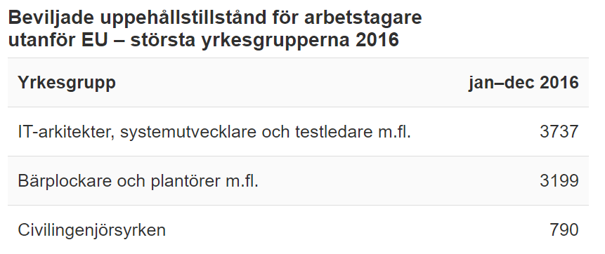
What does it cost?
Notes:
There is a huge untapped economic potential in utilizing the workforce provided by our immigrating population. The graph to the left shows that the money used on educating a single doctor in Sweden could be used to integrate three foreign doctors. It’s a three for one deal. The graph to the right shows that there is a ten respectively a seven percent discrepancy between foreign born and native born people when it comes to occupancy and unemployment rates. We clearly have to remedy this problem!

Slide 4

Viable Employment Processing
SOCIAL
FINANCIAL
SCALABLE

Slide 5


Slide 6




Idea
What if we could:
Decrease Financial Employment Costs
Decrease the Bias Selection Process
Create Social Involvement

Slide 7
The Skillset Procedure & Algorithm

Slide 8
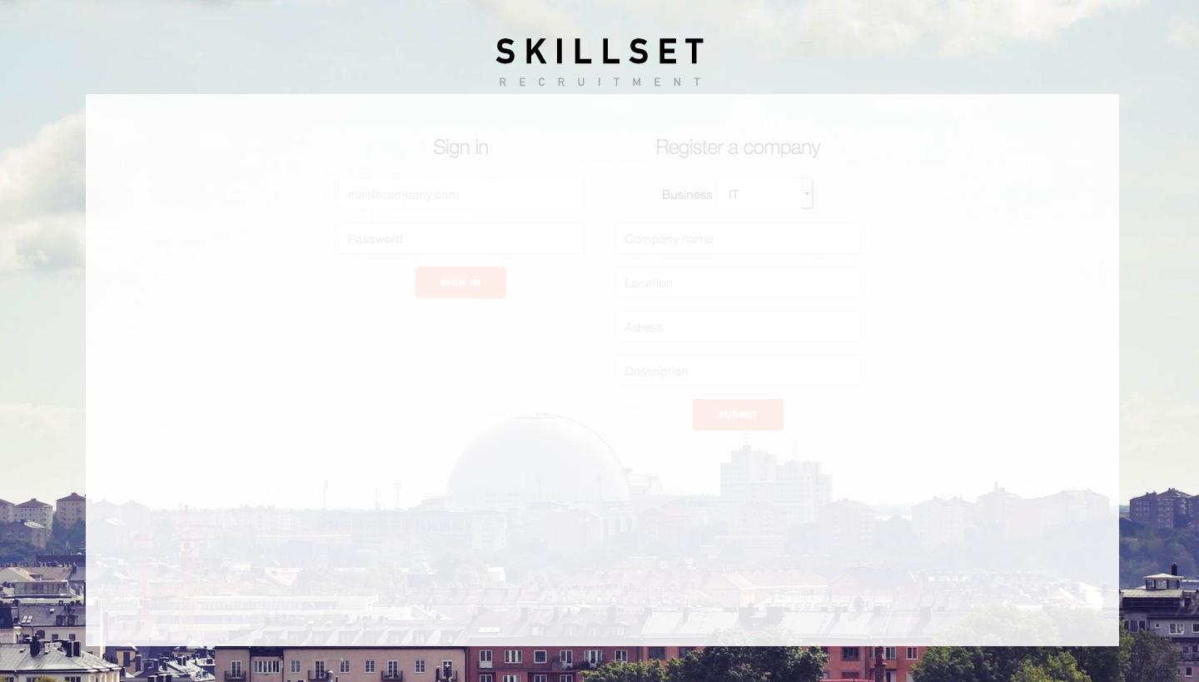

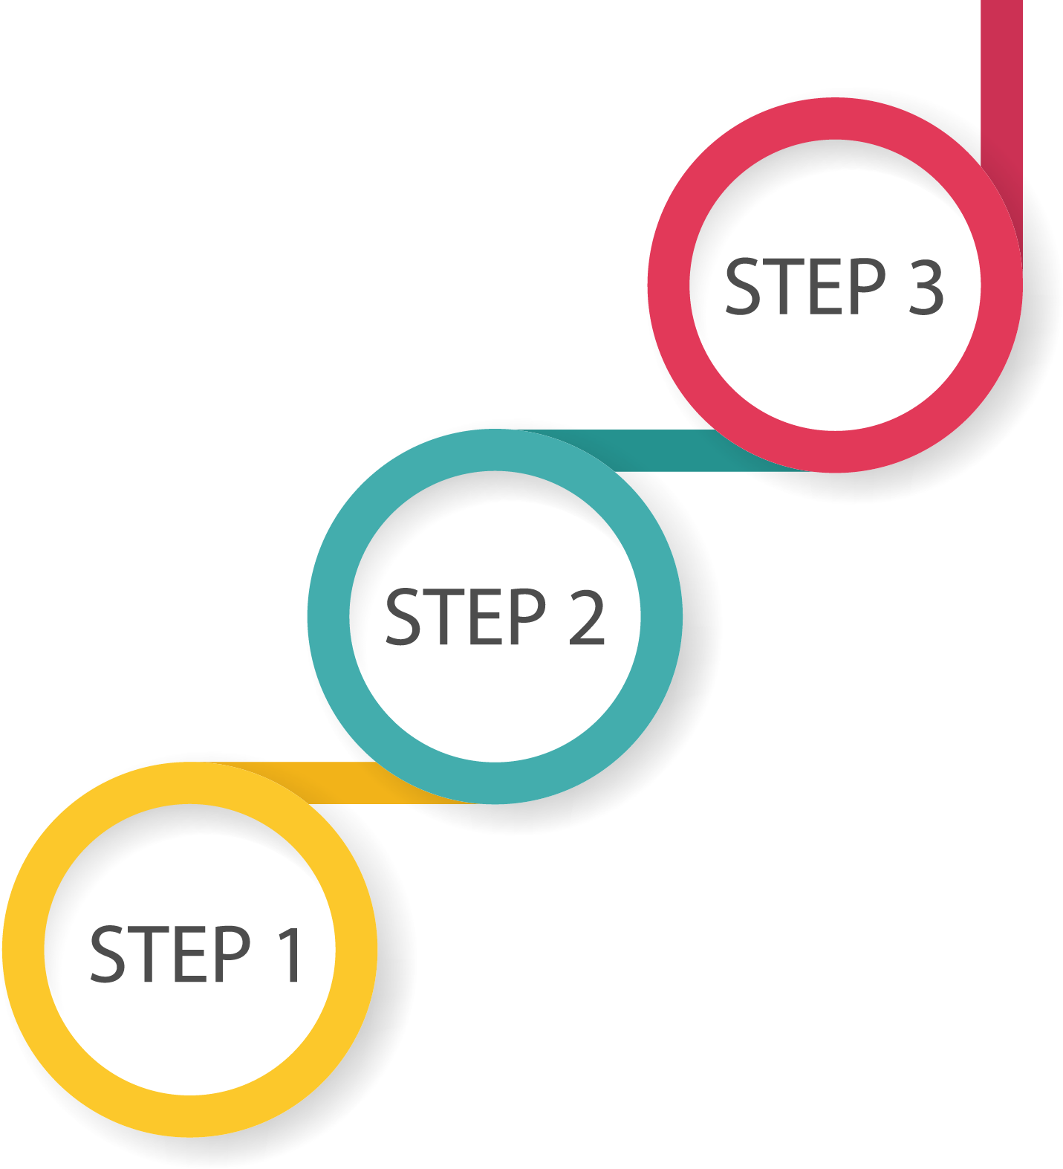



Skillset algorithm
Decide
Peer reviewing
Identification

Slide 9
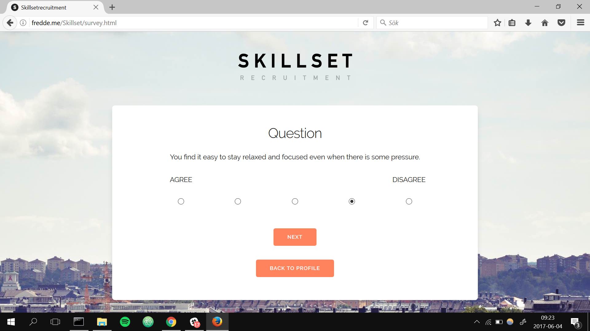

Slide 10
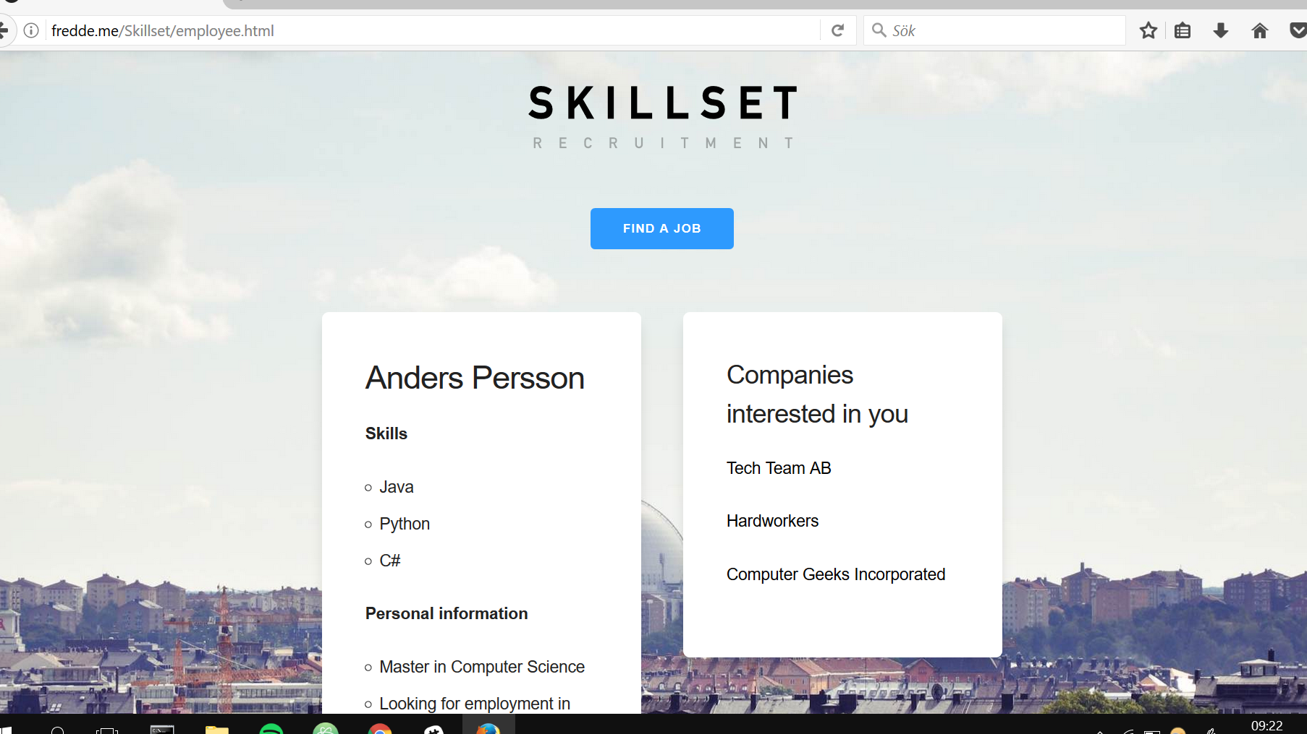

Slide 11
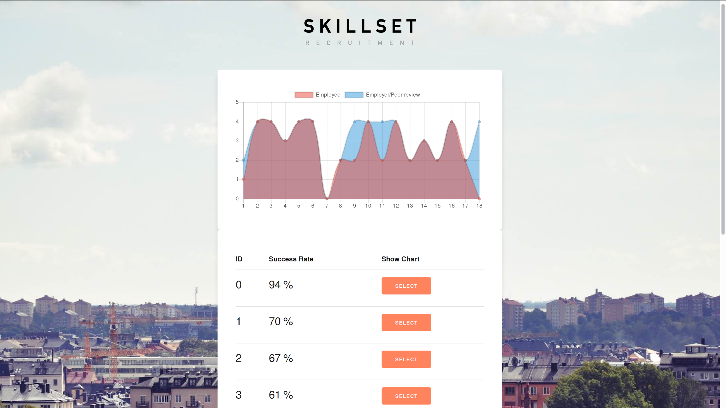

Slide 12

Integration
Inclusion helps retention
Empowerment
Notes:
Many organisations are starting to explore a new approach to improving retention through participative selection. There is a belief that when staff are involved in the recruitment decision they are more likely to support the new staff member, and as a consequence retention is improved.
Many local authorities have been doing this for some time with mixed results. For the process to be meaningful (and legal) each person must be selected or rejected on defined criteria. This makes employee involvement more difficult.
One solution is to use competency based recruitment. Here key aspects of the role are clearly defined and success factors well documented. This can provide a solid framework for employee participation.

Slide 13
Financial Perspective
Passive search through ever-expanding database
Recycle leads, making the job platform more efficient to relevant employers
Effective way of specifying and locating rare abilities and combinations
Notes:
Through a recyclable and expanding database, information can be used by various employers looking for the perfect candidate, while keeping application process as effortless as possible for the job searcher.
Environmental something, save papers maybe?
Makes specifying and locating special competences resource effective and easy

Slide 14
Social perspective
Empower Employees
Avoid Unintentional Discrimination
Equal Treatment
Notes:
Make your employees feel valued and widen your view on who the perfect candidate is.
Bypass the unconscious discrimination that is undoubtedly a part of your hiring process
Get processed based on your quantitative and personal values, without biased view.

Slide 15
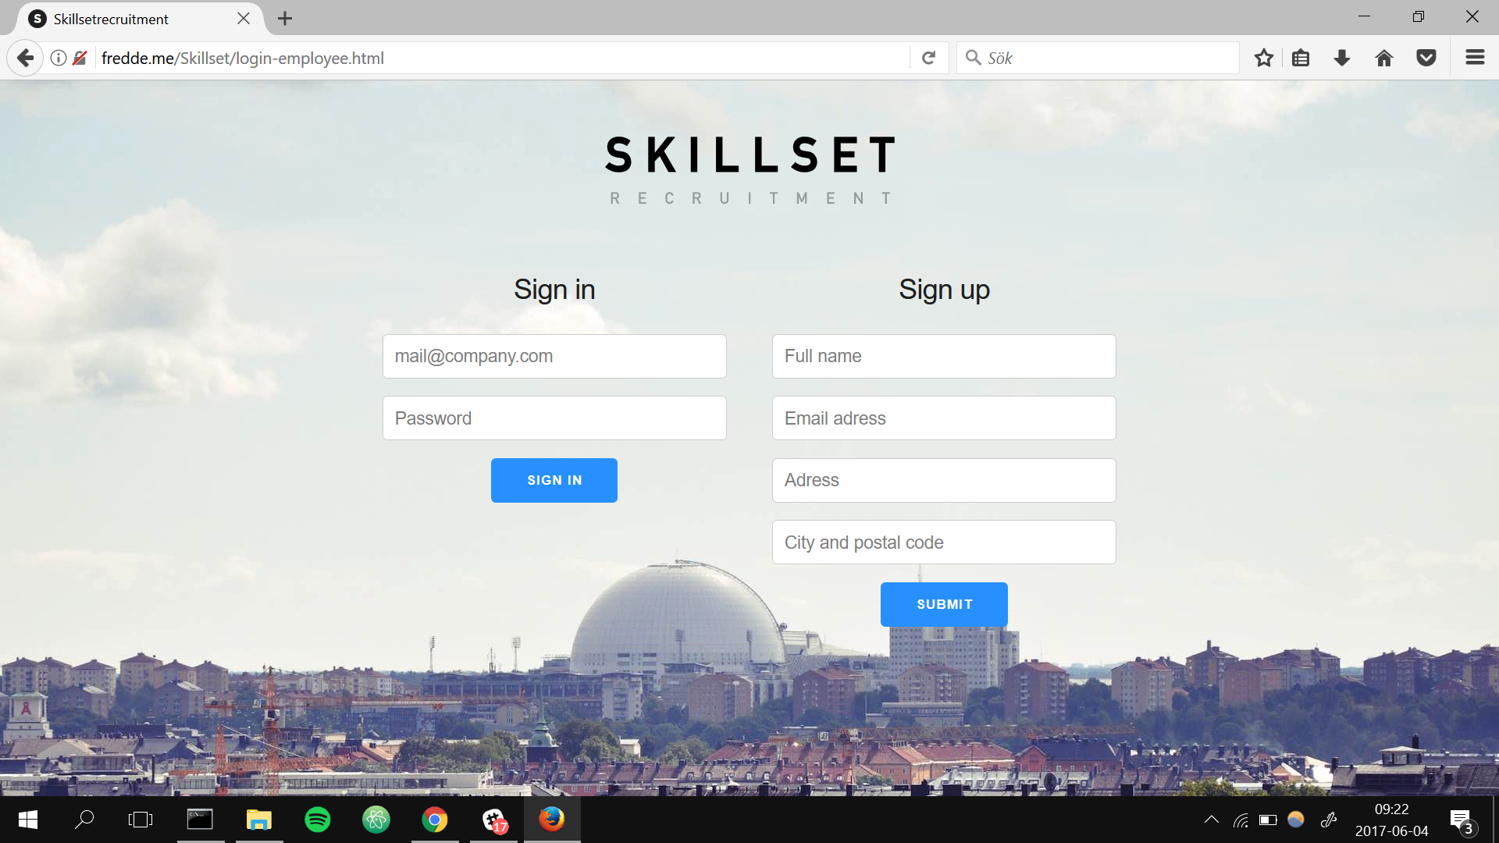

Slide 16
Notes:
We know that this is sustainable

Slide 17
Notes:
We are Skillset Recruitment

